Slide 1
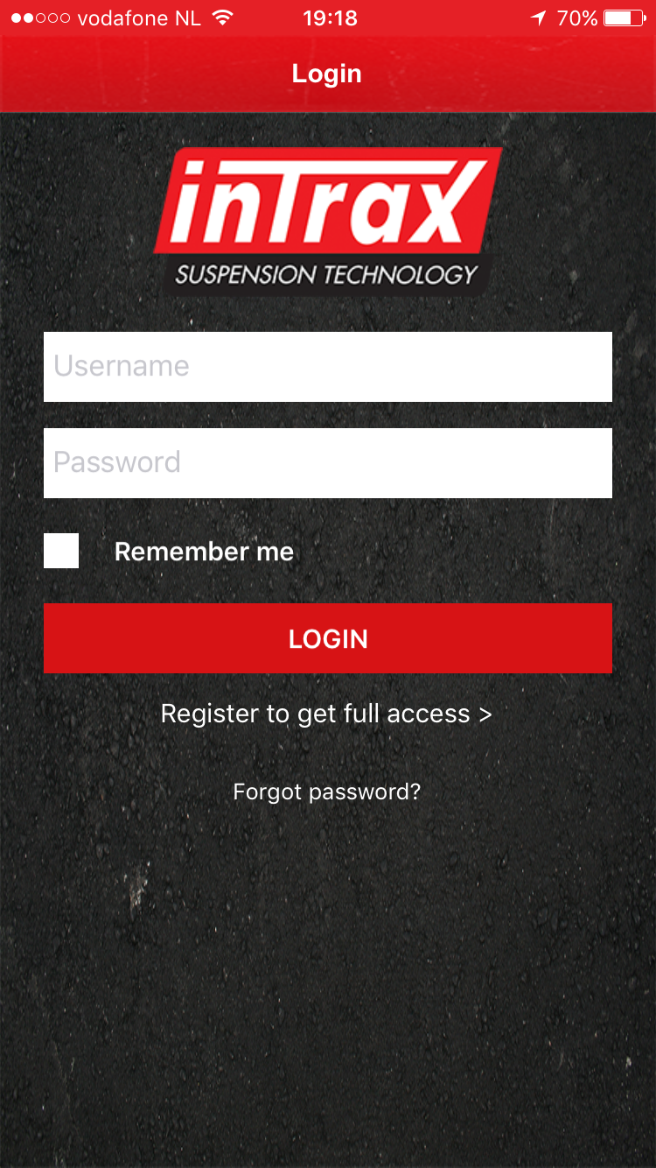
Fill in your username (keep it simple for when you want to share info).
General
Your settings are password protected. No one can see them, you decide if you want to share them and with who.
Password can be changed at all times in the app *
Check “remember me” if you don’t want to enter your username and password each time you open the app
!!! First time ???
Click register and fill in the sheet. You can use the app in no time.
If you forgot your password click here and you will receive a new one by mail. You can change your password afterwards inside the app.

Slide 2
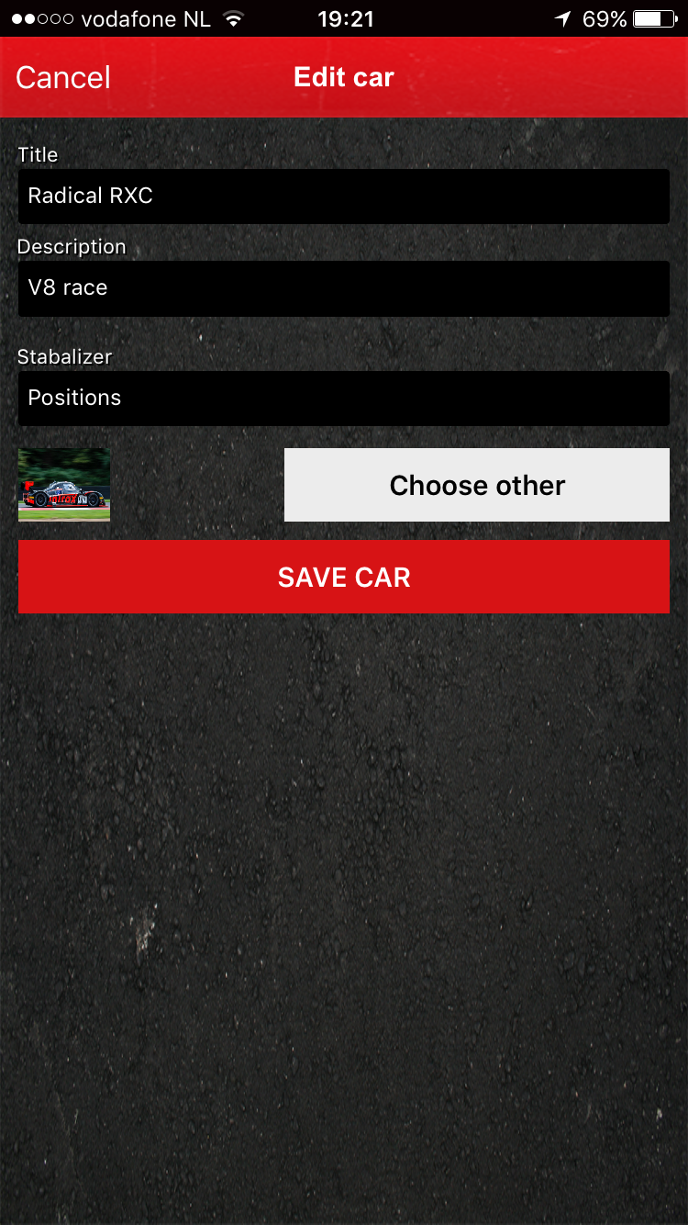
Give the car it’s name
When you have more of cars you can distinguish them here
Choose your stabalizer, holes, or with swords (degrees). You don’t have to use this later if yuou don’t want to
You can add a picture of the car.

Slide 3
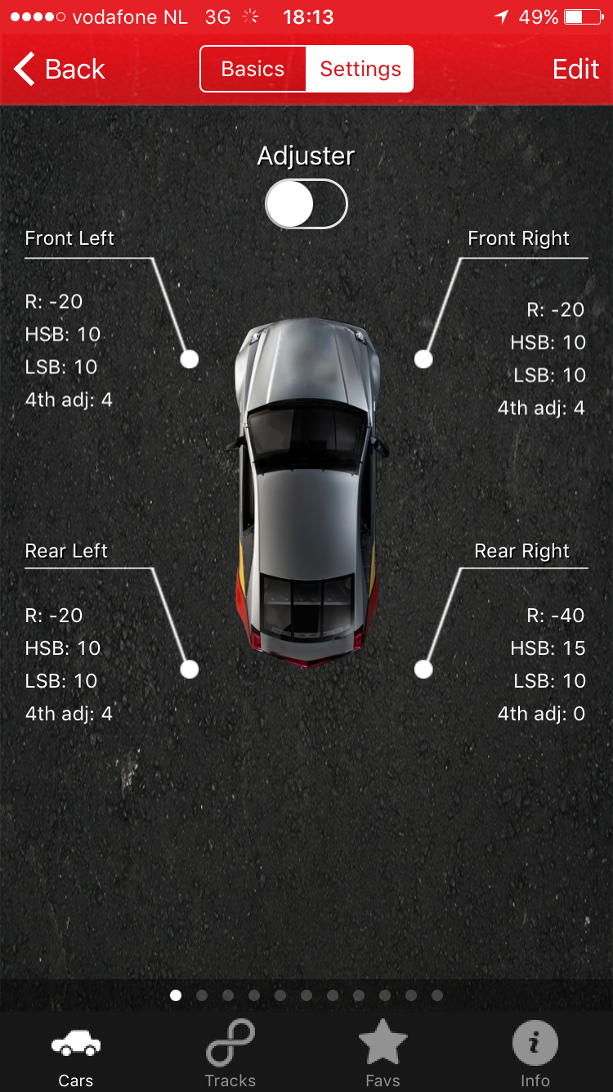
Tab to go back to the basic setting
Tab to change the settings of the page you are on
Tab to synchronise
Scroll left and right to look / add other settings corner weights, drive height etc.

Slide 4
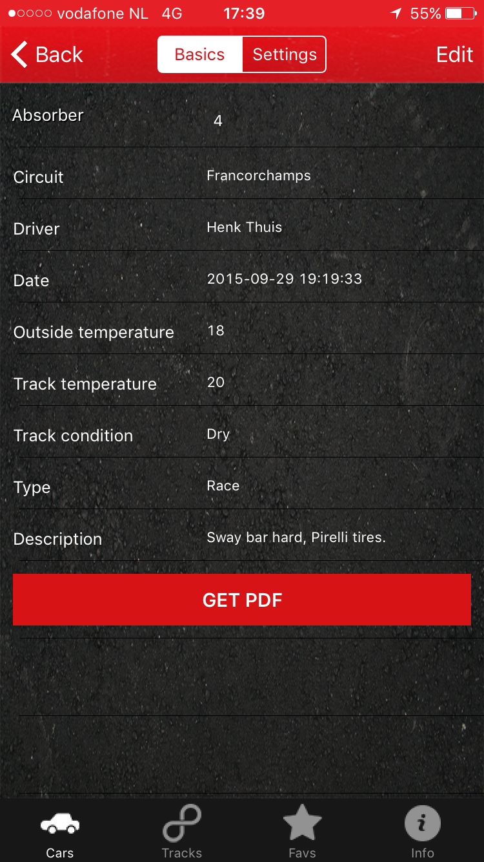
Tab to go to the detailed settings of this car
Tab to change the basics
Tab to enter your shock system
Tab to give the track/road a name on which the setting is tested
Automatically
Free space for comments.
Tab if you want your setting to be mailed

Slide 5
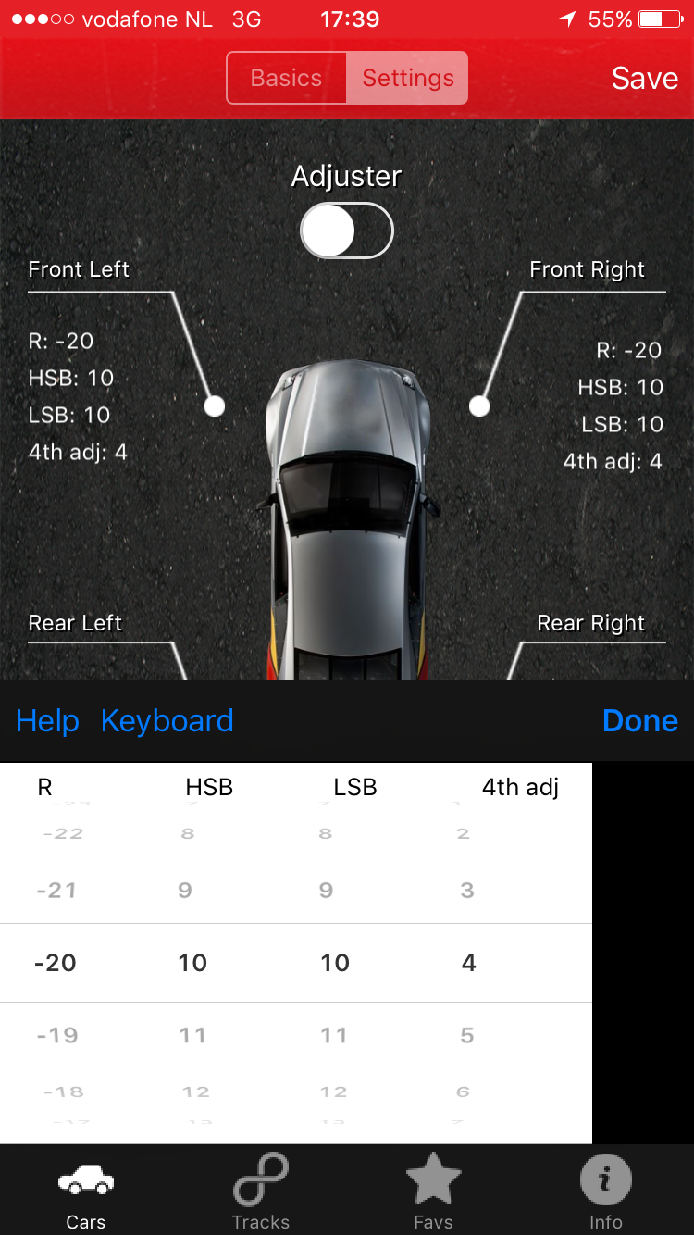
Tab to go to the basics of the car
Tab o to save your changes
Tab if you want left and right to be the same
Automaticly
Tab if you cant use the rolers
Tab if you’re done entering this site/wheel

Slide 6
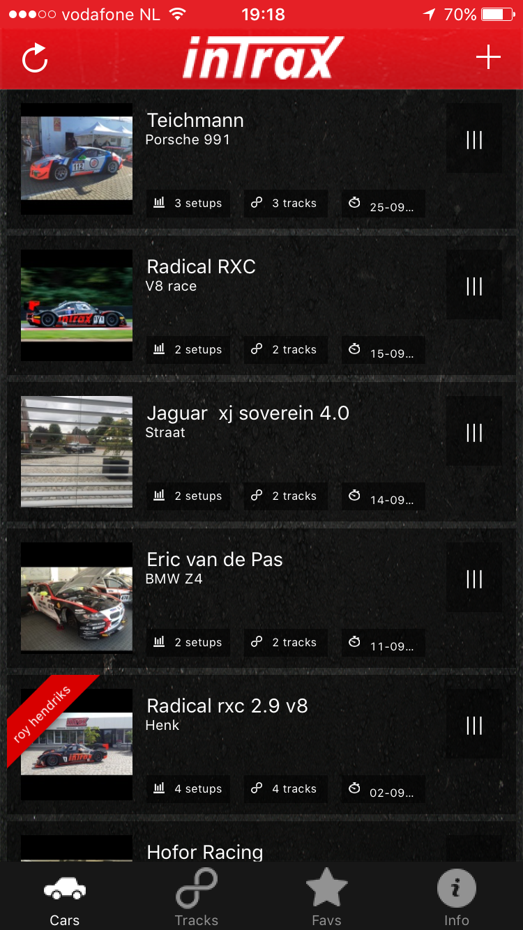
Tap for options
!!! First time ???
Click the + to enter the basics for the car you want to enter
Click the + to enter the basics for the new car you want to enter
Tap for details of that car

Slide 7
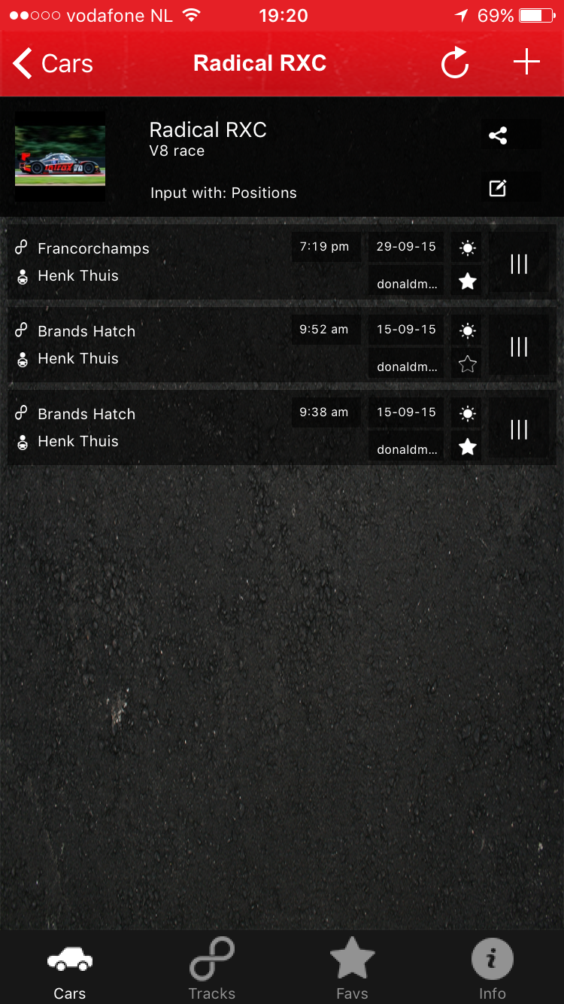
Tap for options
!!! First time ???
Tap the + to enter the details of the car
Tap the + to enter the changes of the circuit, circumstances etc.
Tap for details of that car

Slide 8
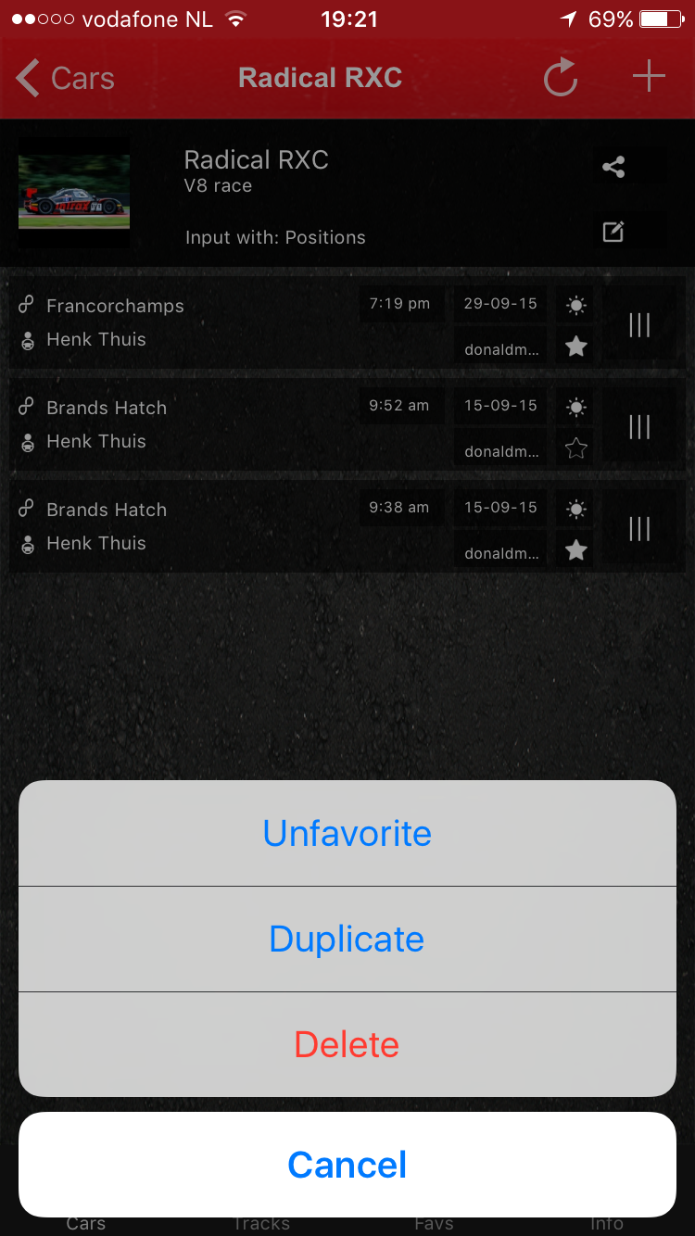
Tap to show the options
Options
Make it favorite or unfavorite
Duplicate setting so you can adjust the changes (other circuit, wet, etc) you made and safe the old setting
Delete the setting

Slide 9
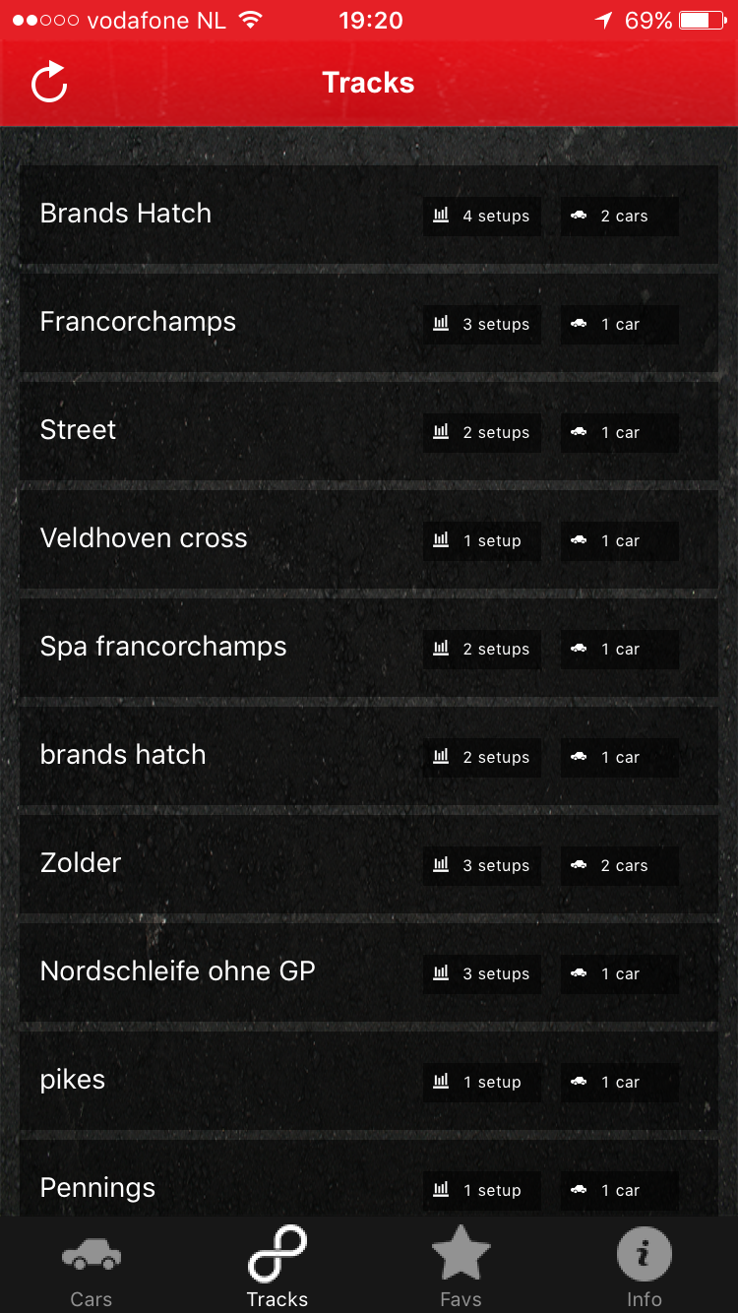
Tap to see the settings you have available for that trackd
Tap to search by track

Slide 10
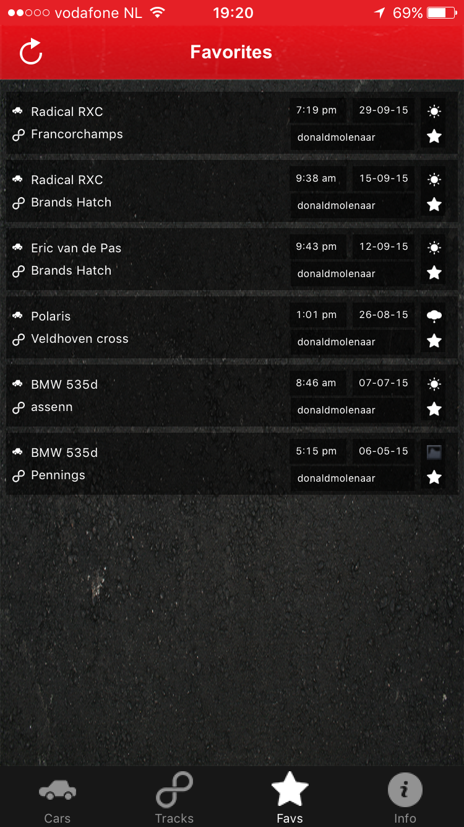
Tap to see the favorite setting
Tap to search by favorites

Slide 11
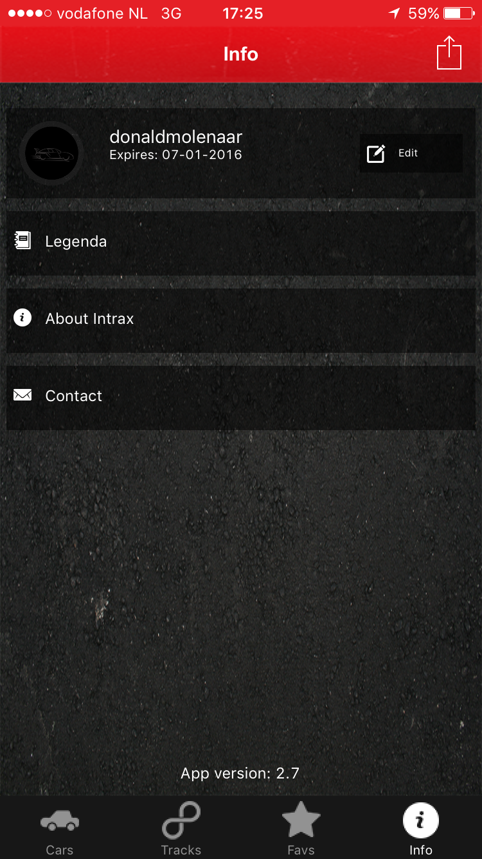
Tap to change password / e-mail address
Tap to see explanation about terms used
Tap to see info about Intrax Suspension Technology
Tap to get in contact with Intrax
Tap to change/check personal info

